Slide 1
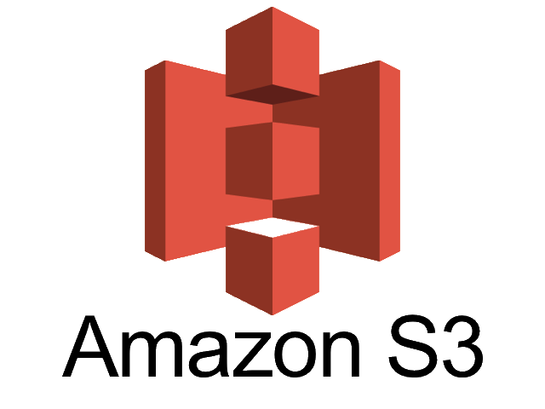








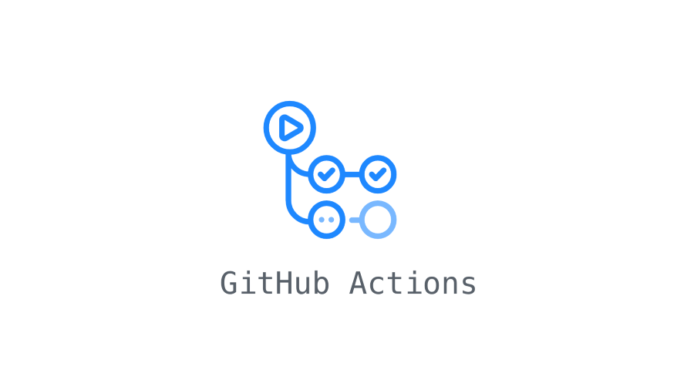


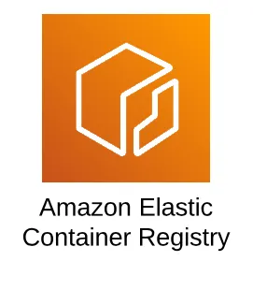
External Data Sources
Data Ingestion
Database
Data Insights
Using API Method Client Dropping the data into S3 Bucket
S3 Bucket will send the event notification to SQS after the new file arrival
Ks - Cluster 1
Ks - Cluster 2
Commit the code changes to git hub repo (prod/dev) Branches
Node -1
Kibana Visualization & Dashboards
Node - 4
Node - 2
Python job pushes the output data to Elasticsearch using elastic search client libraries
Kibana used to create visualization, dashboards for twitter data.
Push the changes in the git hub repo to Container Registry using local machine Compute
Airflow SQS Sensor DAG is created and used to track the notification of new files addition in S3 bucket. Once the notification has received and will trigger the job which present on the container registry and run it
Node - 3
Air Flow

